Slide 1
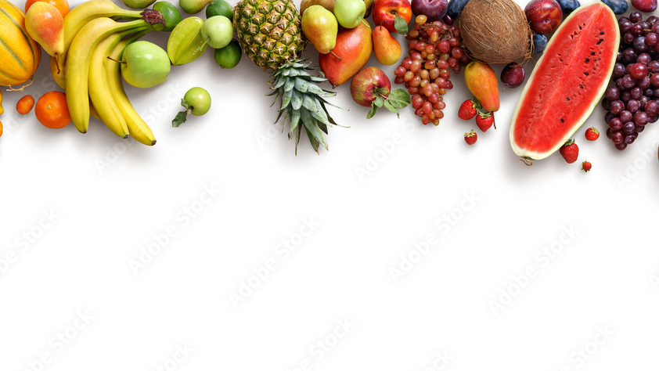
Fruit Eval
Aron Thomas(44) Athul P Shibu(52) Athul Mohan(51) Evana Ann Benny(69)

Slide 2
Group Members And Guide
Dr. Amal M R – Guide
Aron Thomas – Data Model and Training.
Evana Ann Benny – Web Interface Developer.
Athul Mohan – Hardware Implementation.
Athul P Shibu - Hardware Implementation.

Slide 3
Index
Introduction
Problem Definition
System Overview
Functionalities
Timeline
Components
Hardware
Web UI
Software
Courses Taken
Project Status

Slide 4
Problem Definition
Introduction
This is a system that can classify fruits based on their quality.
IoT sensors and camera hardware are used to qualitatively assess the freshness of fruits.
The current agricultural industry faces challenges in efficiently and accurately determining fruit quality, which directly impacts yield, market value, and overall productivity.
Traditional methods are often time-consuming.
This project deals with these problems by creating a robust and efficient solution that assesses fruit quality based on various parameters such as colour, smell, size, texture, and defects

Slide 5
System Overview
The system is composed of two parts: A software part and a hardware part.
The software consists of training a data model to recognize images and a web UI for various inputs and outputs.
The hardware consists of ESP32, and MQ3 odour sensor.
Data from odour sensor and camera are assessed for an accurate prediction of the quality of the fruit.

Slide 6
Functionalities
Odour sensing : Detect and analyse the scent emitted by fruits to assess their freshness or presence of any spoilage.
Image Processing : Capture images of fruits to analyse their external appearance such as colour, size, shape and surface defects
Quality Assessment : Integrate data from odour sensors and image processing to provide a comprehensive evaluation of fruit quality, considering both internal(odour) and external(visual) characteristics.

Slide 7
Timeline
PRE-FINAL STAGE
Interfacing software and hardware components
Data Model Development
INITIAL STAGE
25%
50%
75%
100%
Webpage completion
Web UI
development
Hardware Implementation
INTERMEDIATORY STAGE
FINAL STAGE

Slide 8
Components
The following slides encompass the various hardware and software components used in the project.

Slide 9
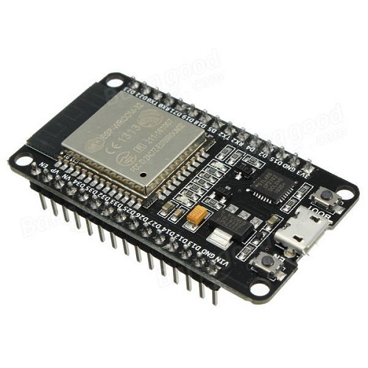
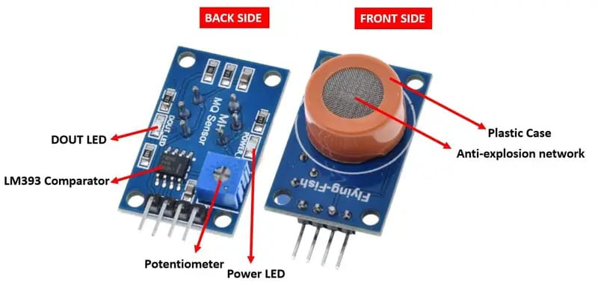
Hardware
ESP32 Devkit V1
MQ3 Sensor
Wi-Fi/Bluetooth microcontroller
Alcohol vapour sensor

Slide 10
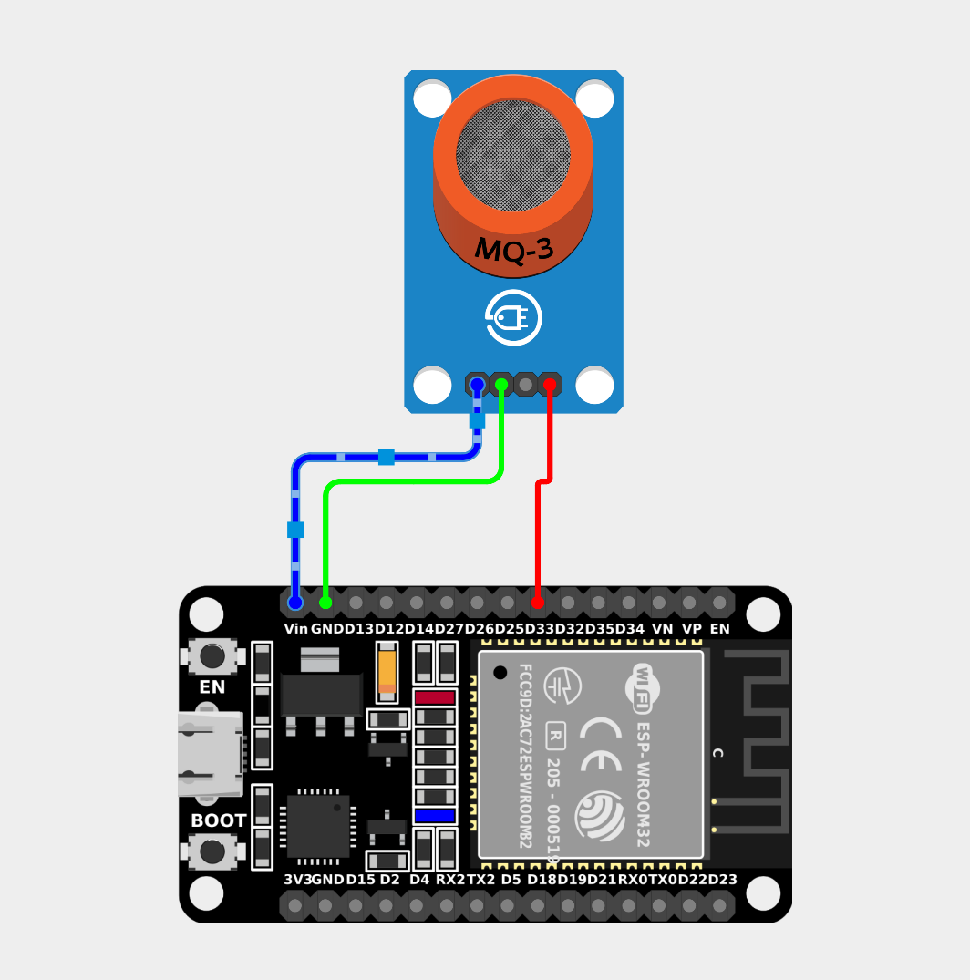
Circuit Diagram

Slide 11
Code
MQ3 is connected to pin D33 of ESP32.
The normal range of MQ3 values in air without any alcoholic content was measured to be around 120-200.
ppm (parts per million) concentration can also be calculated.
A set of values are obtained from MQ3 and the average is calculated.
Based on the value, the status is updated and LED pin is configured.

Slide 12
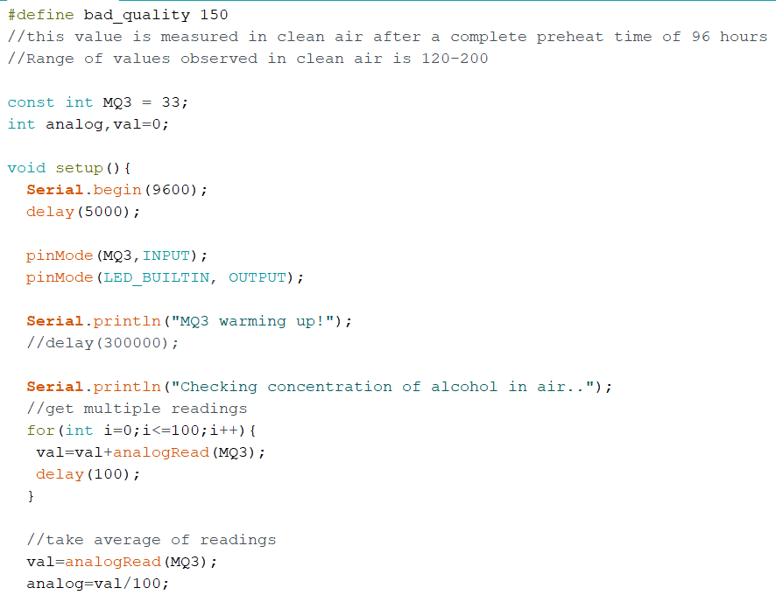
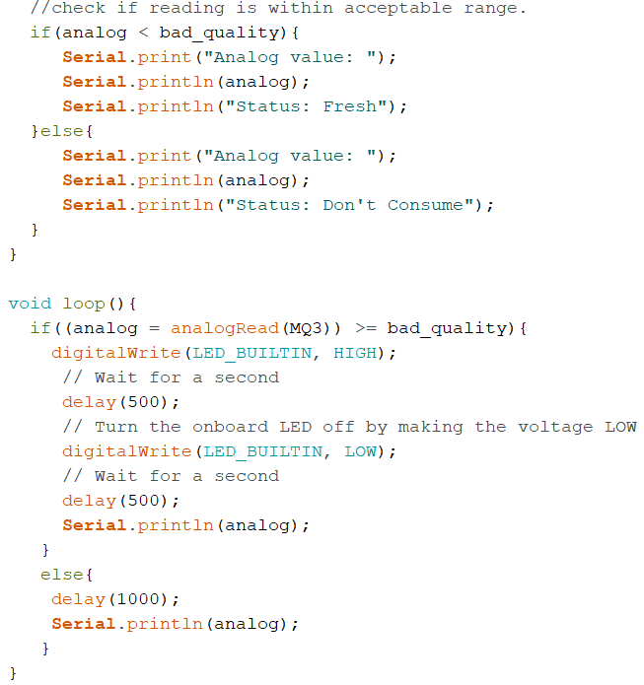

Slide 13


Web UI Tools and Frameworks
<FRONT END>
<BACKEND>

Slide 14
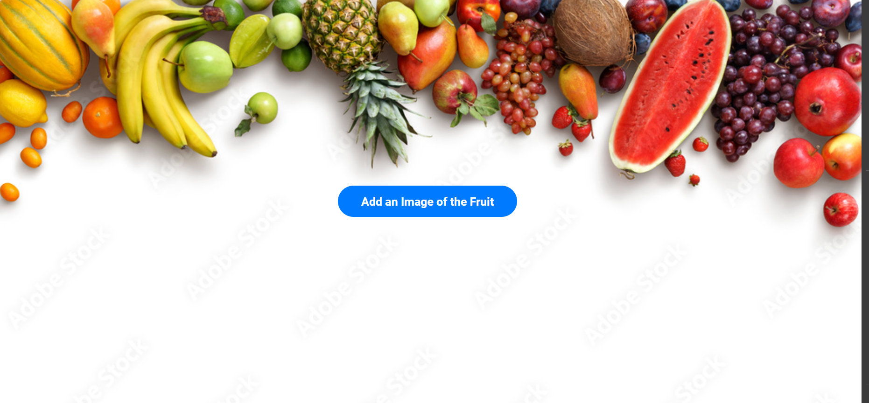
Home page

Slide 15
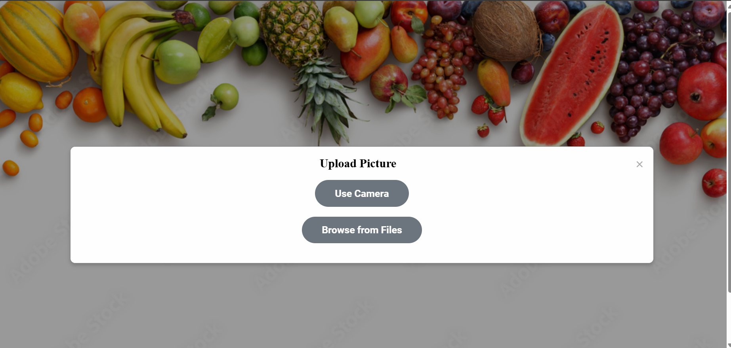

Slide 16
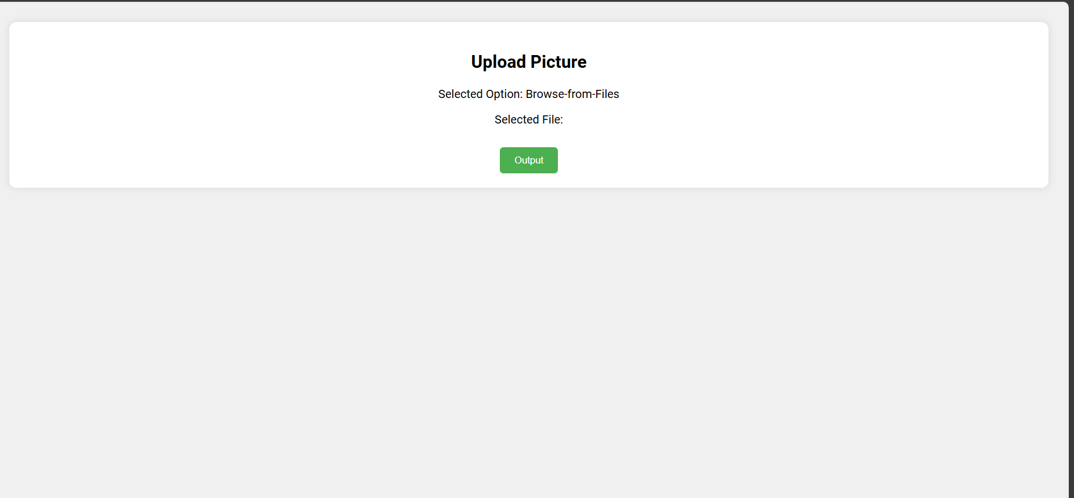
upload.html page
download

Slide 17
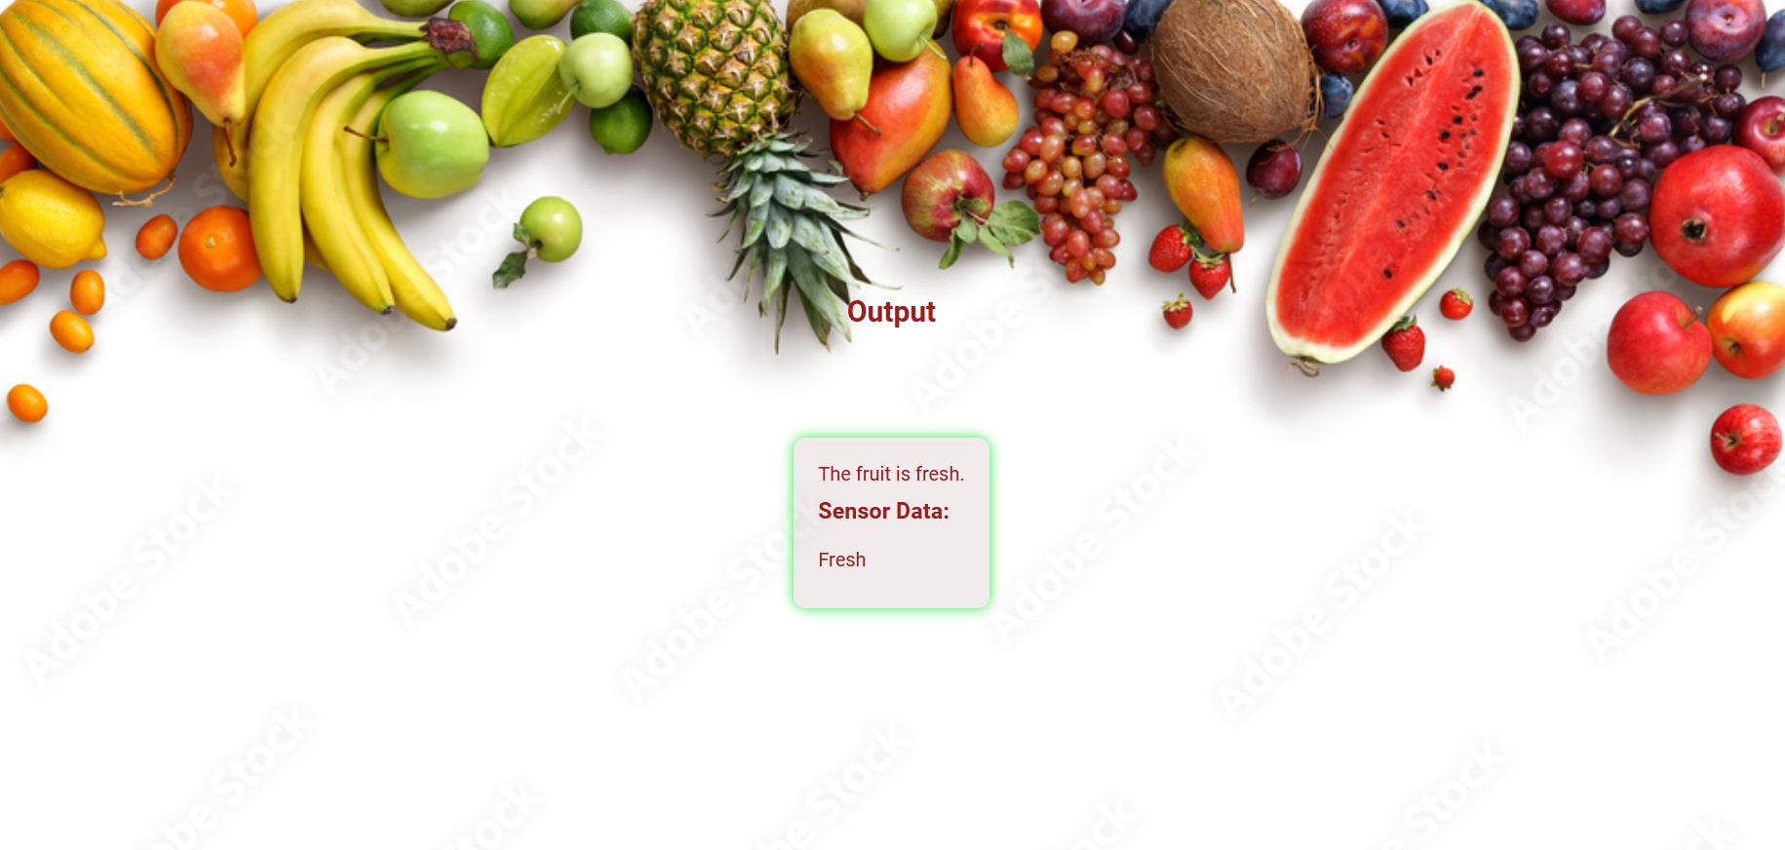
output.html page

Slide 18
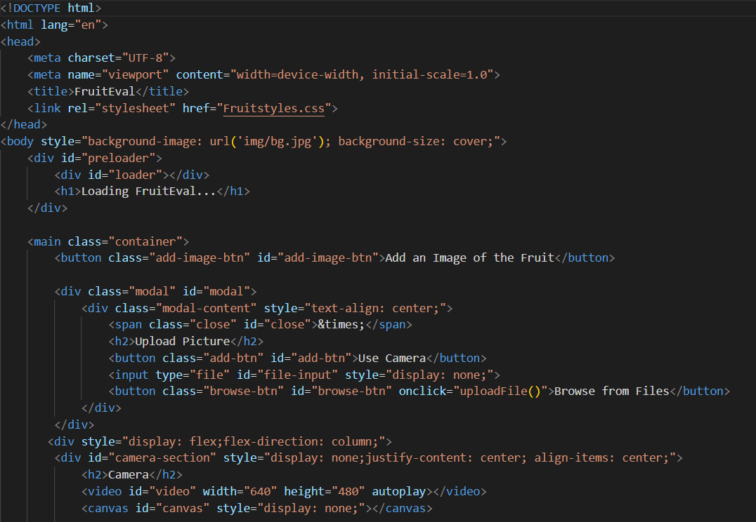
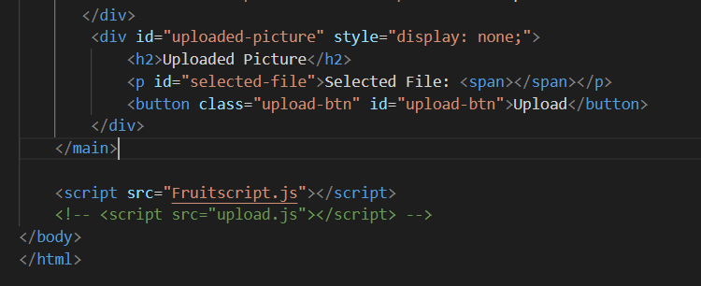
Code – Web UI
Index. html

Slide 19
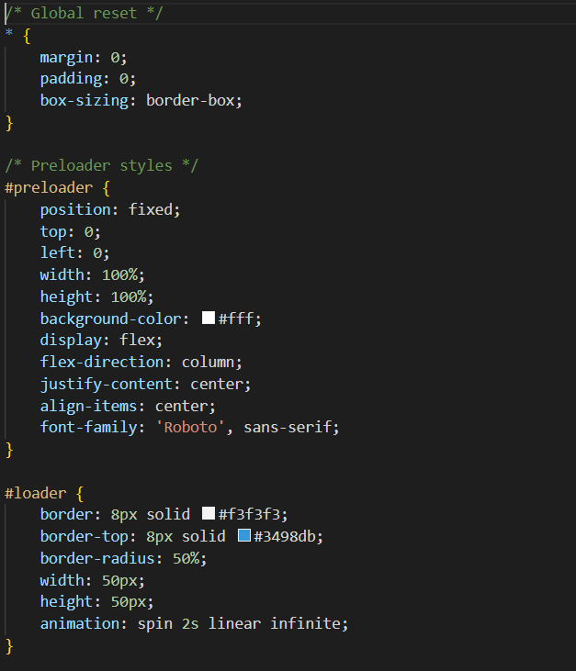
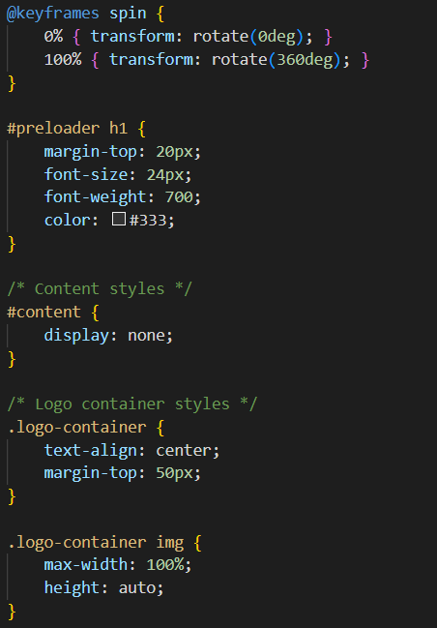
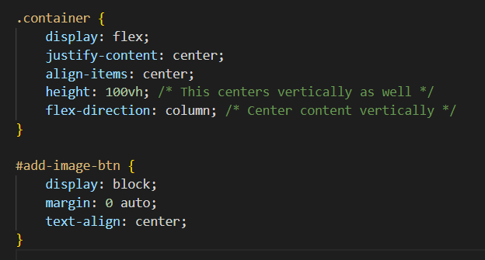
Styles.css

Slide 20
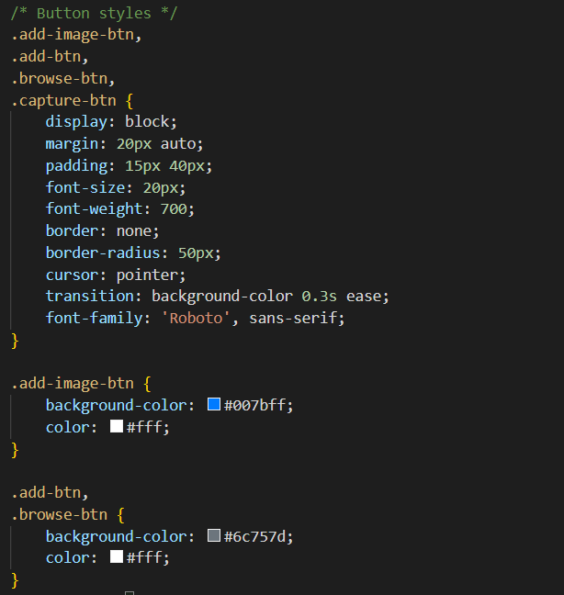
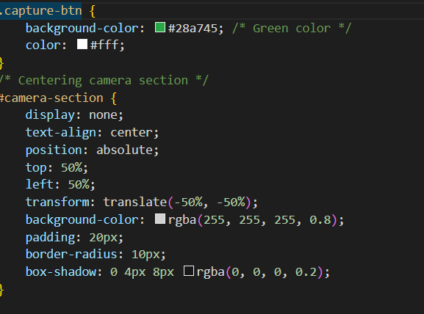
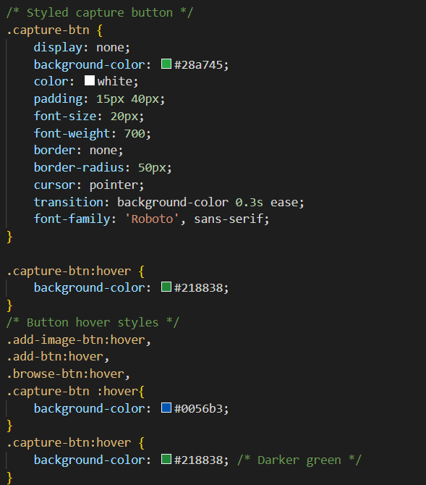

Slide 21
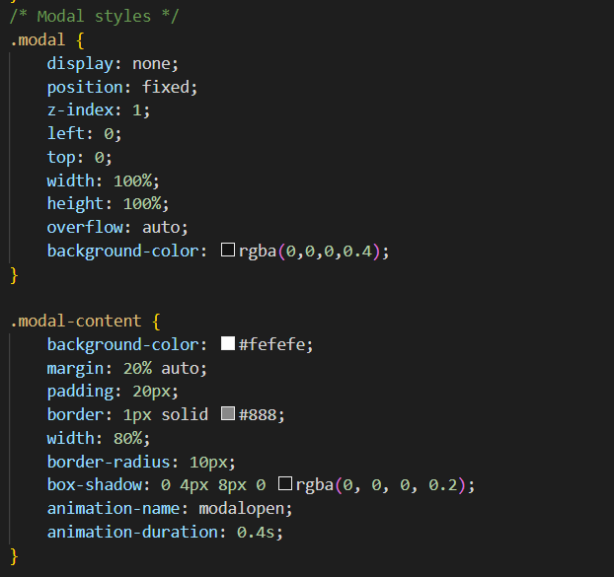
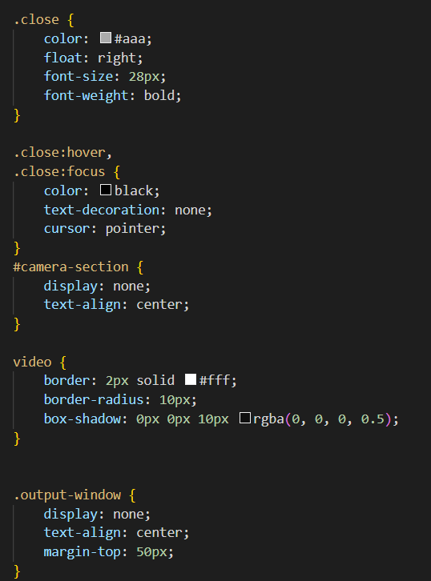

Slide 22
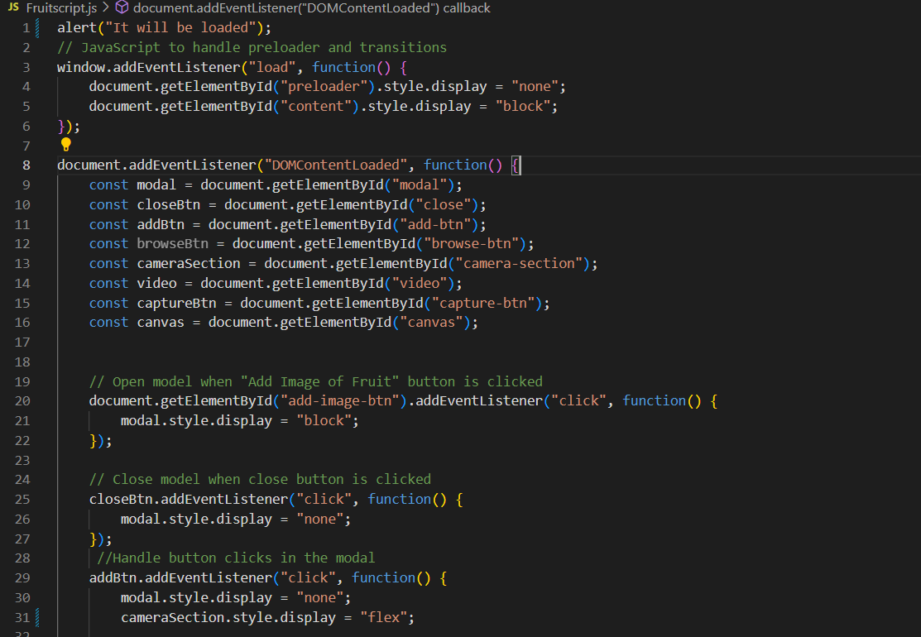
Script.js

Slide 23
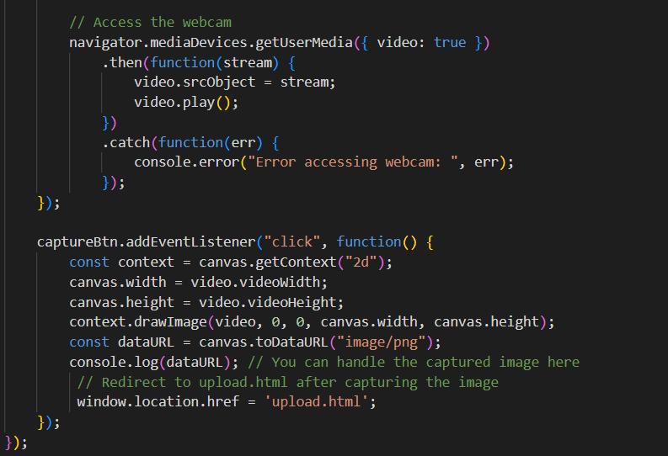

Slide 24
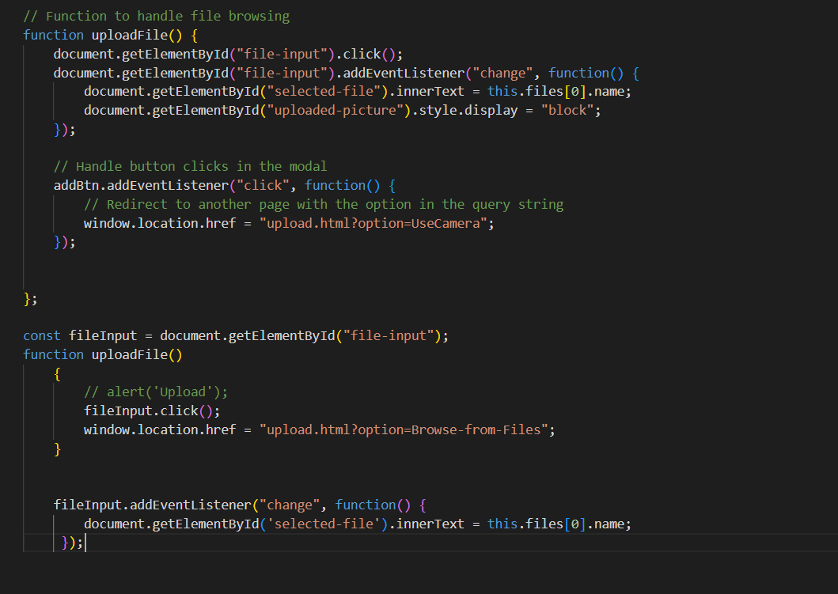

Slide 25
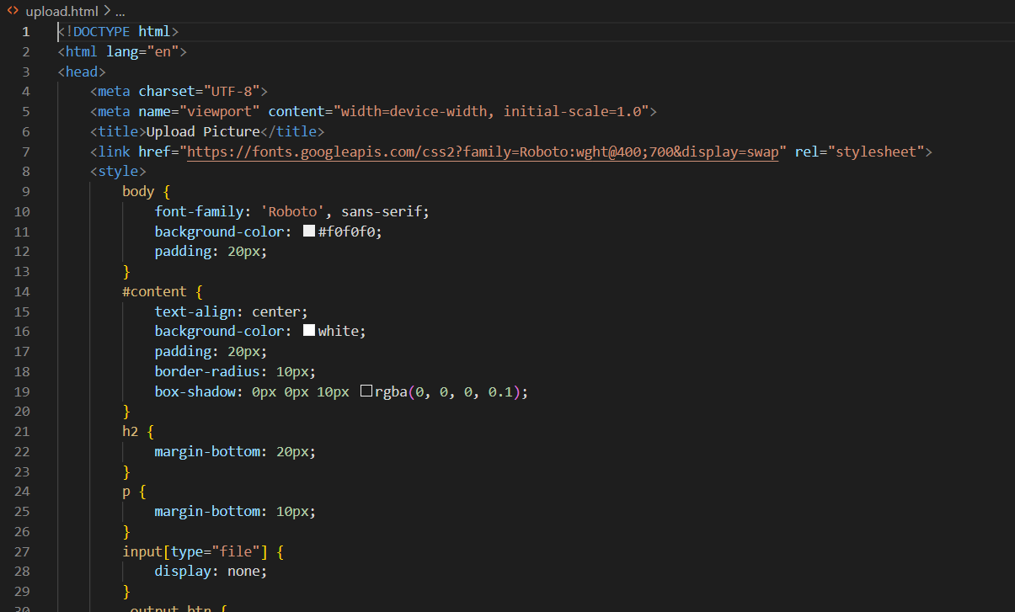
Upload.html

Slide 26
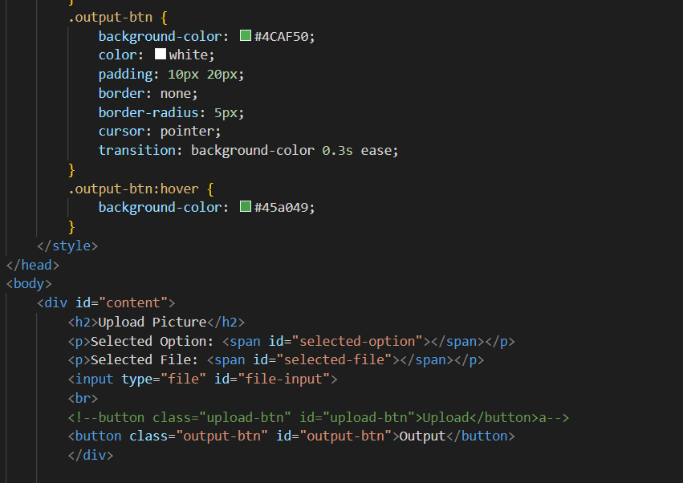

Slide 27
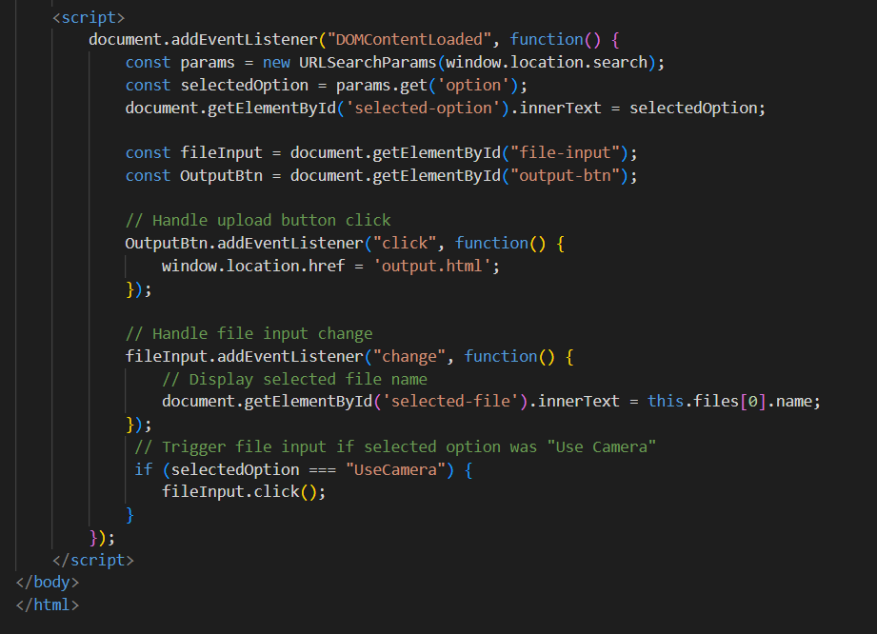

Slide 28
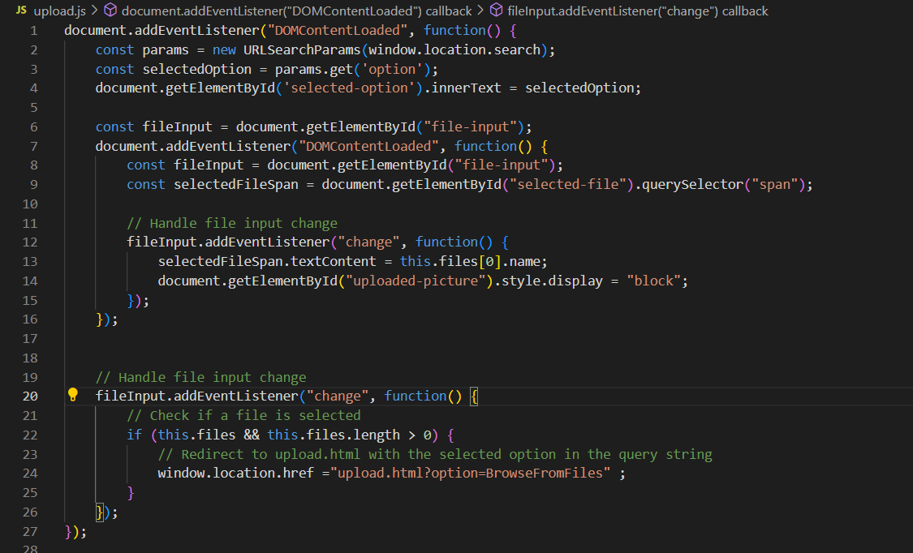
Upload.js

Slide 29
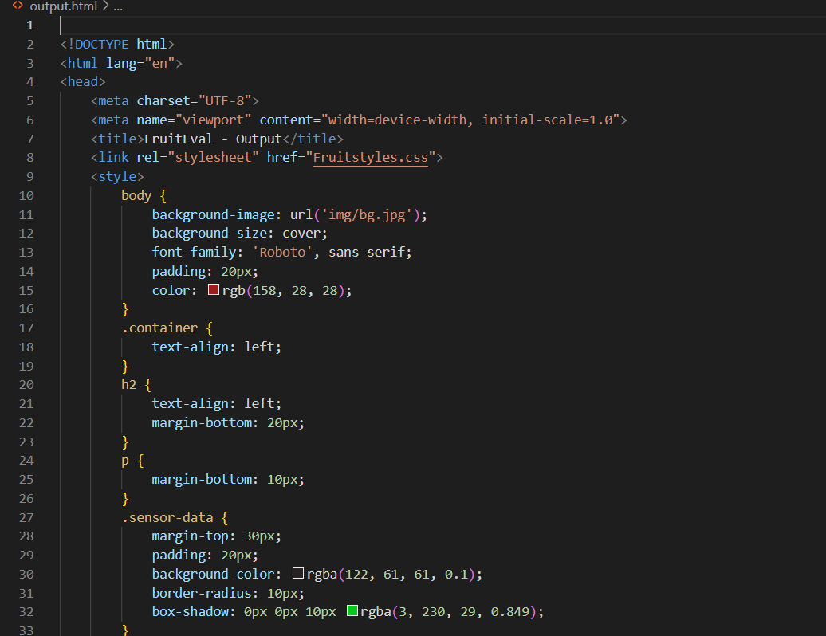
Output.html

Slide 30
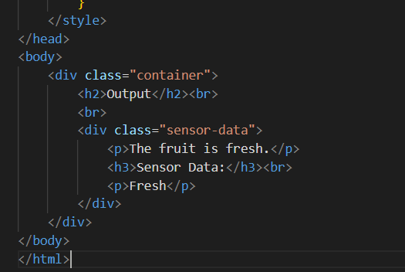

Slide 31
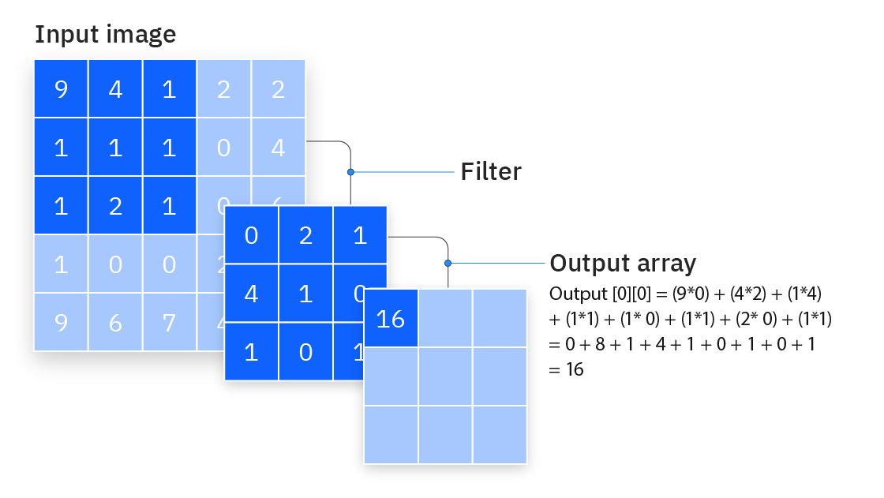
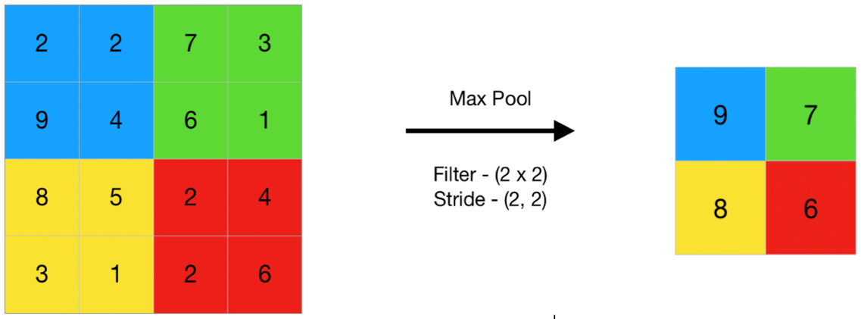
Software
Convolutional Neural Networks
Convolutional Neural Networks(CNNs) are a type of neural network that have high efficiency and accuracy with inputs pertaining to audio, image, speech, etc.
CNNs mainly have three types of layers:
Convolution Layer
Pooling Layer
Fully Connected Layer

Slide 32
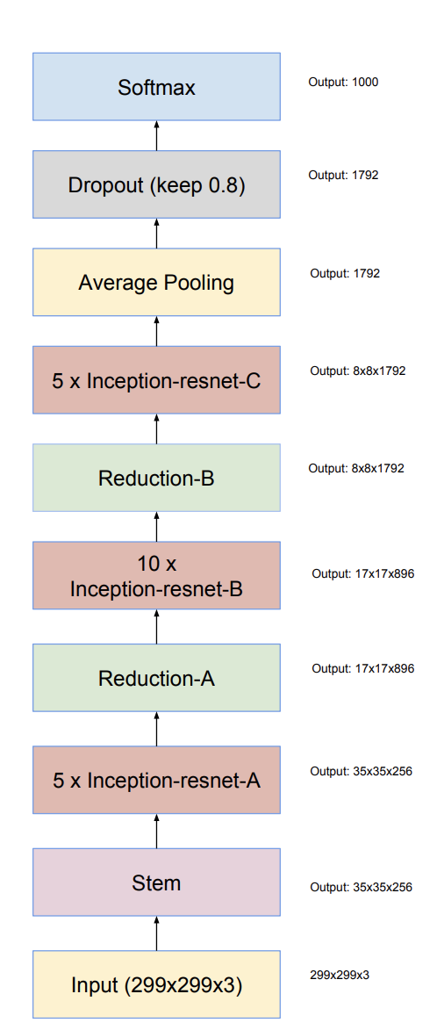
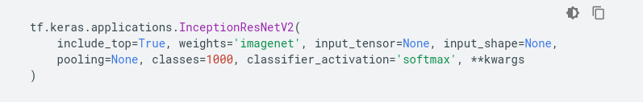
Data Model
Inception-ResNet-v2
A convolutional neural network that is pre-trained on more than a million images from the ImageNet database.
ImageNet
An image database organized according to the WordNet hierarchy in which each node of the hierarchy is depicted by hundreds and thousands of images.
Notes:
Total number of layers - 467
Total number of convolution layers – 186
Total number of pooling layers – 4 max, 2 average

Slide 33
Data model used for transfer learning : Inception-ResNet-V2
Dataset used for model training : FruitNet
Total number of training images : 18,452
Total number of image classes : 12
Total number of model parameters trained : 18,444
Epochs trained : 10
Optimizer used : Adam
Achieved accuracy : Training - 89.10% ,Validation – 92.65%
Loss minimization : Training – 35.64% ,Validation – 27.76%

Slide 34
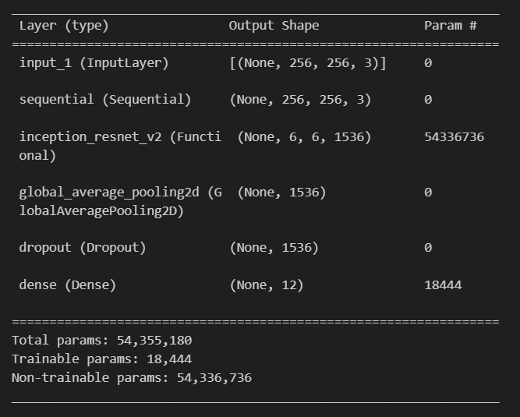
Model Summary

Slide 35
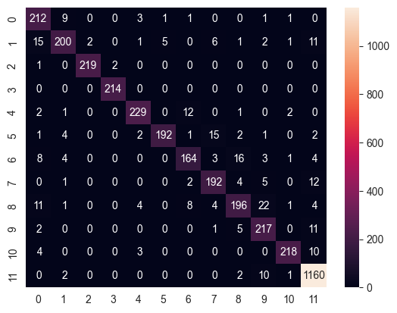
Confusion Matrix

Slide 36
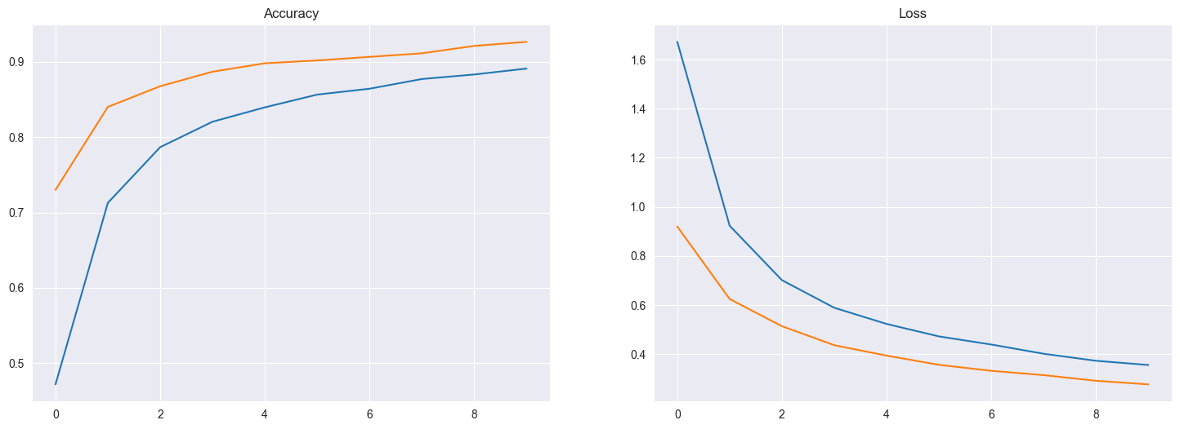
Graphs of Accuracy and Loss
blue line - training orange line - validation

Slide 37
Courses Taken by The Team Members
Aron Thomas – Introduction to Machine Learning – IIT Madras
- Deep Learning – IIT Ropar
Evana Ann Benny – Machine learning for finance
Athul Mohan – Machine Learning with python
Athul P Shibu – Internet of Things and Communication Models

Slide 38
THANK YOU

